Slide 1

HUM111 Pakistan Studies
Lecture 08

Slide 2
HUM 111 Pakistan Studies
Lecture 08
Historical Events 1940-1947
Dr. Sohail Ahmad

Slide 3

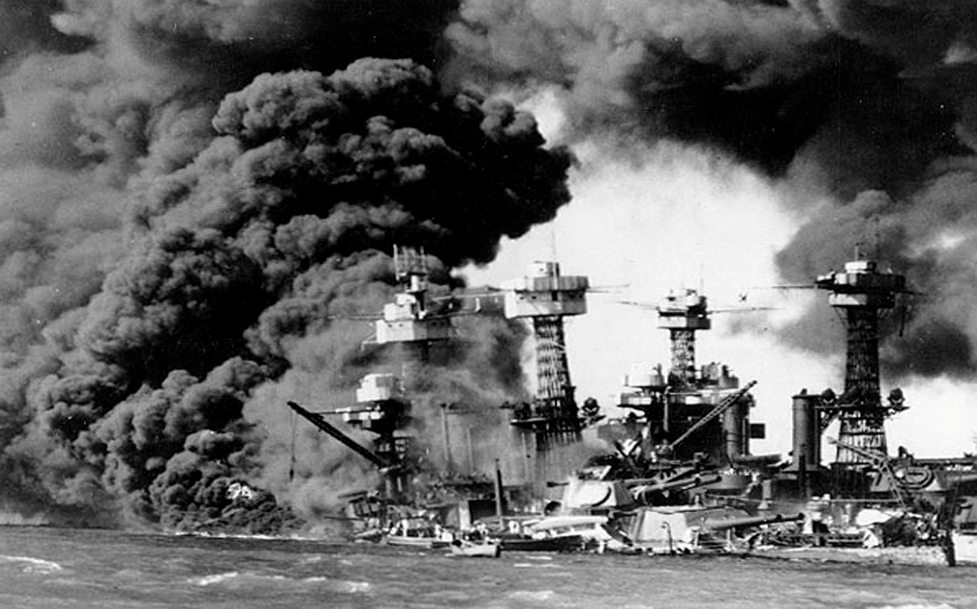
Causes of Cripps Mission
Japan’s Attack

Slide 4
Causes of Cripps Mission
Japan’s Attack
Japan had already attacked Pearl Harbour on 7th December 1941 the American Naval Base and destroyed it.
It had taken over Philippines, Malaysia and come to the borders of Assam.
Japan could easily attack India. To check the situation, Sir Stafford Cripps, a member of the war cabinet, was sent to India in March 1942 to get India’s cooperation to fight the war.

Slide 5
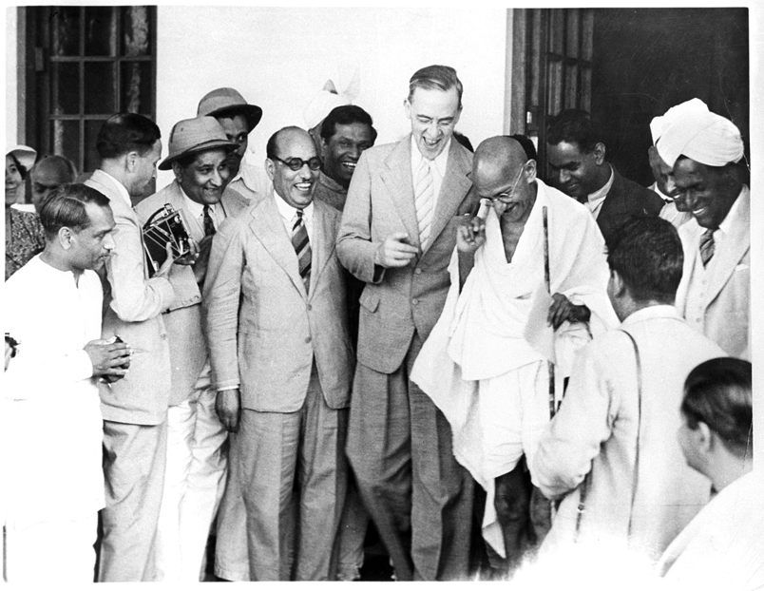
Cripps Proposal

Slide 6
Cripps Proposal
Give India dominion status after war like that enjoyed by Canada and Australia.
Promise of the formation of a constituent assembly to finalize the constitution.
Princely states to be free to join India or remain independent.
Provinces could decide to be separate from India and frame their own constitution.
Till further notice, the defense would be handled by the British government.

Slide 7
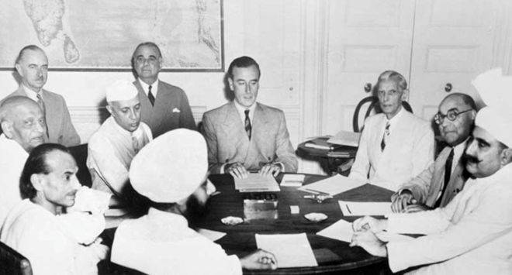
Rejection of Cripps Proposal

Slide 8
Rejection of Cripps Proposal
Division of the nation
The proposal put up the point of division of India into a number of independent States which was against its unity.
No time limit for the dominion status
British did not declare when the dominion status would be given. The declaration was vague.
Representatives of princely states nominated
The people of the Princely States were denied the right to elect a representative of their own. They would be nominated by the rulers of those States.
Gandhiji criticized Cripps Proposal as ‘post dated cheque on a failing bank’. The Muslim League reject the Cripps Proposal as it did not clearly state the decision of partition and the formation of a Muslim State.

Slide 9
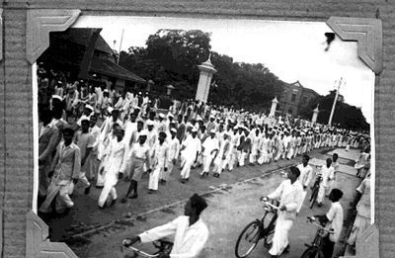
Causes of the Quit India Movement 1942

Slide 10
Causes of the Quit India Movement 1942
Failure of Cripps mission
The dominion status promised by Cripps was rejected by both Congress and Muslim League. Now there was no other option left but to go for something stronger.
Communal flare up in India
Muslim League’s declaration of Pakistan in 1940 had spread communal disharmony between the Muslims and Hindus. The British were deliberately playing up the Muslim community which was smoldering as the Muslims disliked the idea of a Hindu majority party headed by the Congress. Their minority disliked being ruled over by a Hindu majority party.
Japanese threat
The Japanese had come up to Burma. They would attack India anytime till the time it was under British occupation. It would be better if India was independent before the Japanese decided to attack India. British would not be able to stop the Japanese from attacking India. This would be the best time to strike for total independence.

Slide 11
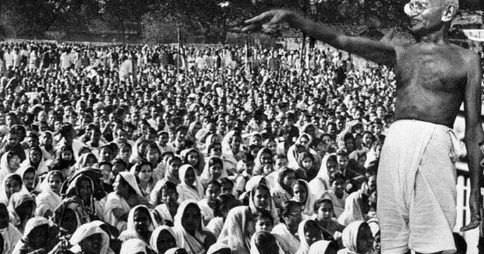
Impact of the Quit India Movement 1942

Slide 12
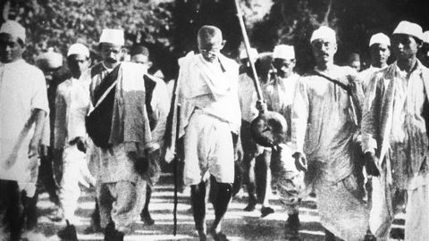
Impact of the Quit India Movement 1942

Slide 13
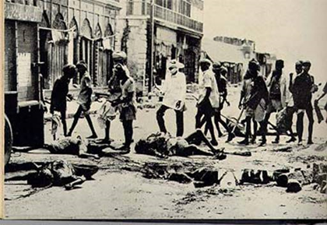
Impact of the Quit India Movement 1942

Slide 14
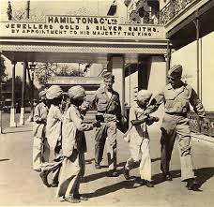
Impact of the Quit India Movement 1942

Slide 15
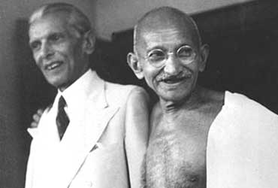
Impact of the Quit India Movement 1942

Slide 16
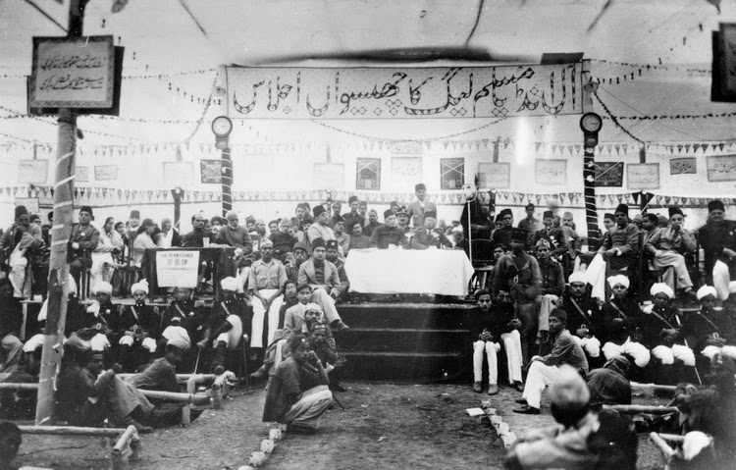
Impact of the Quit India Movement 1942

Slide 17
Impact of the Quit India Movement 1942
Mass movement
With large number of people participating in it coming from all sections and backgrounds made it the biggest mass movement after 1930. The people’s reaction demanding British withdrawal from India was astounding.
British made to feel unwelcome
British felt unwelcome and unwanted due to this mass uprising. The participation was breath taking with even some the princely states joining on board the movement.
British repression
British used severe repression measures by lathi charging, jailing and shooting down people to no avail. The rising tide of people protesting could not be checked despite brutal repression.

Slide 18
Impact of the Quit India Movement 1942
Second rung leadership
With the arrest of the leaders like Gandhi and Nehru, there appeared a second rung leadership in the underground with leaders, who led from the front, like Ram Manohar Lohia, Aruna Asaf Ali, Jaiprakash Narayan, Achyutrao Patwardhan and Nana Patil. They kept on the fight alive against the British setting up parallel government in the states like UP, Maharashtra, West Bengal.

Slide 19
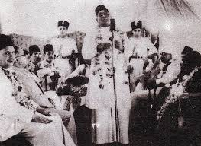
Muslim League Response to Quit India

Slide 20
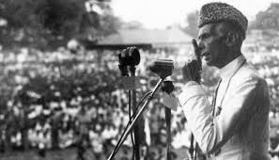
Muslim League Response to Quit India

Slide 21
Muslim League Response to Quit India
Muslim did not blindly plunge into the “Quit India”
Jinnah asked for “Divide and Quit India”

Slide 22
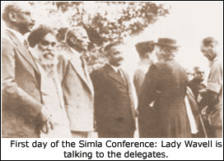
Wavell Plan and Simla Conference [1/7]

Slide 23
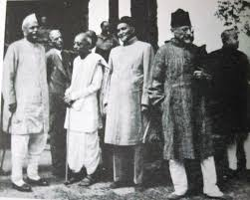
Wavell Plan and Simla Conference [2/7]

Slide 24
Wavell Plan and Simla Conference [3/7]
In May 1945, Lord Wavell, the Viceroy of India, went to London and discussed his ideas about the future of India with the British administration.
To discuss these proposals with the leadership of major Indian parties, Wavell called for a conference at Simla on June 25, 1945.

Slide 25
Wavell Plan and Simla Conference [4/7]
If all the Indian political parties would help the British in the war then the British Government would introduce Constitutional Reforms in India after the war.
Viceroy’s Executive Council would be immediately reconstituted and the number of its members would be increased.
In that Council there would be equal representation of high class Hindus and the Muslims.
Other minorities including low-caste Hindus, Shudders and Sikhs would be given representation in the Council.

Slide 26
Wavell Plan and Simla Conference [5/7]
All the members of the Council, except the Viceroy and the Commander-in-Chief would be Indians.
An Indian would be appointed as the member of Foreign Affairs in the Council. However, a British Commissioner would be appointed to look after the matters relating to the trade.
Defense of India was to be in the hands of a British authority till Power was transferred to the Indian hands
Viceroy would convene a meeting of the Indian politician including the leaders of Congress and the Muslim League so that they could nominate the names of the members of the new Council.

Slide 27
Wavell Plan and Simla Conference [6/7]
If this plan is approved for the Central Government then same type of popular ministries comprising of the political leaders would be formed in all the provinces.
None of the changes suggested will in any way prejudice or prejudge the essential form of the future permanent Constitution of India

Slide 28
Wavell Plan and Simla Conference [7/7]
Leaders of both the Congress and the Muslim League attended the conference, which is known as the Simla Conference.
Differences between the leadership of the two parties on the issue of representation of the Muslim community. The Muslim League claimed that it was the only representative party of the Muslims in India.
Congress, which had sent Maulana Azad as the leader of their delegation, tried to prove that it represented all the communities living in India.

Slide 29
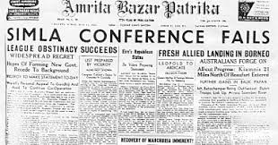
Outcome of the Conference

Slide 30
Elections 1945-1946 [1/3]
The deadlock made Wavell to announce the failure of his efforts on July 14.
No hopes to proceed further.
Provincial and General Elections [1945-46].
With the failure of the Simla Conference, Lord Wavell announced that the Central and Provincial Legislature elections would be held in the winter of 1945, after which a constitution-making body would be set up.

Slide 31
Elections 1945-1946 [2/3]
He also announced that after the elections, the Viceroy would set up an Executive Council that would have the support of the main Indian political parties. Both the Muslim League and the Congress opposed the proposal.
Quaid-i-Azam declared that Muslims were not ready to accept any settlement less than a separate homeland.
The elections were held in two stages. In December 1945, the central legislative assembly was elected and provincial elections were held in early 1946.

Slide 32
Elections 1945-1946 [3/3]
Congress won a total of 930 seats, gaining an absolute majority in eight provinces.
The Muslim League captured 428 out of the possible 492 Muslim seats.
The elections of 1945-1946 proved that Muslim League (ML) alone represented the Muslims of India. The sweeping majority of ML increased Congress hostility towards the ML.

Slide 33
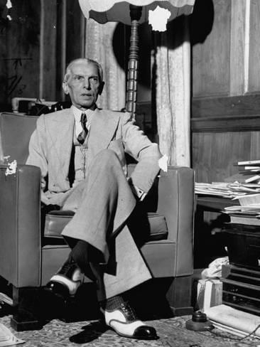
Elections 1945-1946

Slide 34
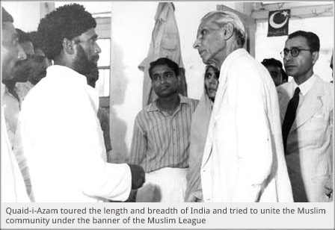
Elections 1945-1946

Slide 35
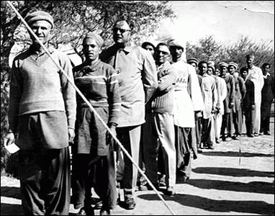
Elections 1945-1946

Slide 36
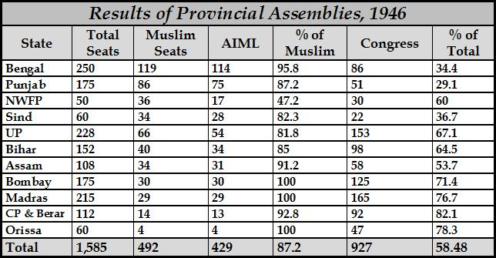
Elections 1945-1946

Slide 37
Cabinet Mission Plan 1946 [1/7]
The results of the general elections held in 1945-46 served to underline the urgency to find a solution to the political deadlock which was the result of non-cooperation between the two major parties.
To end this, the British government sent a special mission of cabinet ministers to India.

Slide 38
Cabinet Mission Plan 1946 [2/7]
Members of the mission were Lord Pethic Lawrence, the Secretary of State for India, Sir Stafford Cripps, President of the Board of Trade, and A. V. Alexander, the First Lord of the Admiralty.
The purpose of the mission was:
It was to devise a machinery to draw up the constitution of independent India.
Setting up of a constitution body.
Thus the mission was like a declaration of the independence of India.

Slide 39
Cabinet Mission Plan 1946 [3/7]
The cabinet plan proposed that there shall be a Union of India which was to be empowered to deal with the defense, foreign affairs and communication.
It recommended an undivided India and turned down the ML’s demand for a separate state.
It restricted the Communal representation and provided that all the members of the Interim cabinet would be Indians and there would be minimum interference by the Viceroy.
It also provided for formation of constituent assembly on democratic principle of population

Slide 40
Cabinet Mission Plan 1946 [4/7]
It recognized Indian right to cede from the Commonwealth.
The Union government and its legislatures were to have limited powers, dealing with Defense, Foreign Affairs, and Communications. The Union would have powers necessary to raise finances to manage subjects. Thus, the mission proposed a weak center.
All the subjects other than the Union subjects and all the residuary powers would be vested in the provinces.
The princely states would retain all the subjects and all residuary powers

Slide 41
Cabinet Mission Plan 1946 [5/7]
A constituent assembly would consist of 389 members to draft the constitution out of whom 292 would be from provinces. Out of these 292, 93 members would be from Princely States.
India would be divided into three groups.
Group “A” was to consist of Bihar, Bombay, U.P. Madras, Orissa and C.P.
Group “B” comprised of Punjab, Sindh, NWFP and British Baluchistan.
While group “C “included Asam and Bengal. These groups were given the authority to frame their constitution jointly with the other provinces of their respective groups

Slide 42
Cabinet Mission Plan 1946 [6/7]
Meanwhile Jawaharlal Nehru, addressing a press conference on July 10, said that the Congress had agreed to join the constituent assembly, but saying it would be free to make changes in the Cabinet Mission Plan.
Under these circumstances, the Muslim League disassociated itself from the Cabinet Plan and resorted to “Direct Action” to achieve Pakistan. As a result, Viceroy Wavell invited the Congress to join the interim government, although it had practically rejected the plan.

Slide 43
Cabinet Mission Plan 1946 [7/7]
However, the Viceroy soon realized the ineffectiveness of the scheme without the participation of the League. Therefore, on October 14, 1946, he extended an invitation to them as well.
On March 22, 1947, Lord Mountbatten arrived as the last Viceroy. It was announced that power would be transferred from British to Indian hands by June 1948.

Slide 44
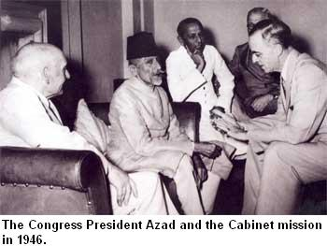
Cabinet Mission Plan 1946

Slide 45
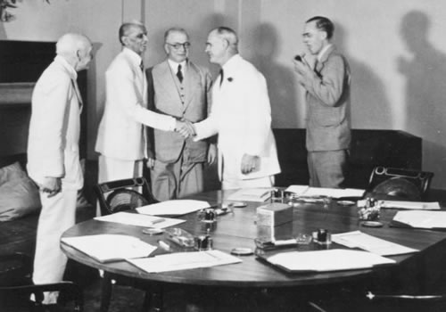
Cabinet Mission Plan 1946

Slide 46
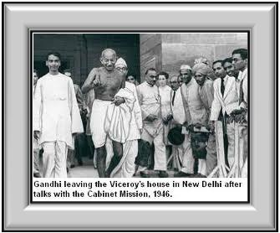
Cabinet Mission Plan 1946

Slide 47
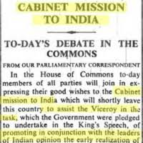
Cabinet Mission Plan 1946

Slide 48
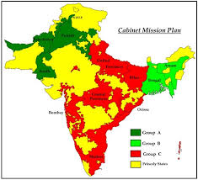
Cabinet Mission Plan 1946

Slide 49
Towards Partition
Lord Mountbatten entered into a series of talks with the Congress and the Muslim League leaders.
Quaid-i-Azam made it clear that the demand for Pakistan had the support of all the Muslims of India and that he could not withdraw from it.

Slide 50
3rd June plan Lord Mountbatten [1/2]
When all of Mountbatten’s efforts to keep India united failed, he asked to chalk out a plan for the transfer of power and the division of the country. It was decided that none of the Indian parties would view it before the plan was finalized.
The plan was finalized in the Governor’s Conference in April 1947, and was then sent to Britain in May where the British Government approved it.
The plan was made public on June 3, and is thus known as the June 3rd Plan.

Slide 51
3rd June plan Lord Mountbatten [2/2]
It was comprised of the following points on the basis of which Britain, after dividing it, was to quit India:
Two separate states will be established in India.
The present constitution assembly will to act but its constitution will not be applicable on the areas which will not accept it.
The power will be transferred the same year (1947) to the representatives of India.
The Muslim majority areas and the Hindu majority distinct of Bengal and Punjab will decide in separate meeting to accept or not to accept the division of the provinces. If anyone of the two groups will opt division, the province will be divided.
The Muslim majority areas which will not opt to join present constituent assembly, will create their separate constituent assembly.

Slide 52
Radcliffe Award/ Boundary Commissions
It was provided in the June 3 plan that as soon as the legislatures of Punjab and Bengal decided in favor of partition, a boundary commission should be set up to demarcate the boundaries.
The legislatures of Bengal and Punjab voted in favor of partition. Boundary commissions were set up for Punjab and Bengal under the chairmanship of Sir Radcliffe. Each commission was to consist of an equal number of representatives of India and Pakistan and one or more impartial members.

Slide 53
Radcliffe Award/ Boundary Commissions
The final award was announced on 17 August, 1947. The Radcliffe Award was unfair to Pakistan because it awarded many Muslim majority areas in Punjab and Bengal to India. Calcutta was given to India.
Muslim majority tehsils of Gurdaspur and Batala were given to India along with Pathankot tehsil. The Muslim majority tehsil Ajnalain in Amritsar district was also handed over to India.
In Jullundur district the Muslim majority areas in Ferozpur district were also given to India. All of these areas were attached to western Punjab.
This unfair award resulted in India's occupation of Kashmir and snatching from Pakistan important head works and giving them to India.

Slide 54
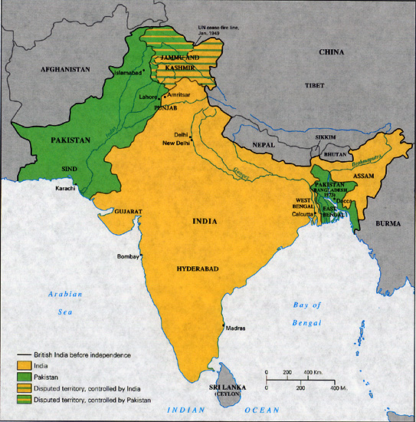
Radcliffe Award/ Boundary Commissions

